Slide 1
Data and Visualization Internship Welcome to your Data!?
The Complex Universe of mtc DATA

Slide 2


Slide 3
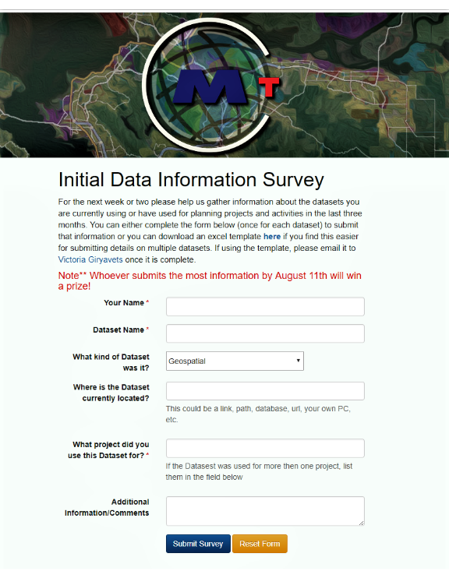
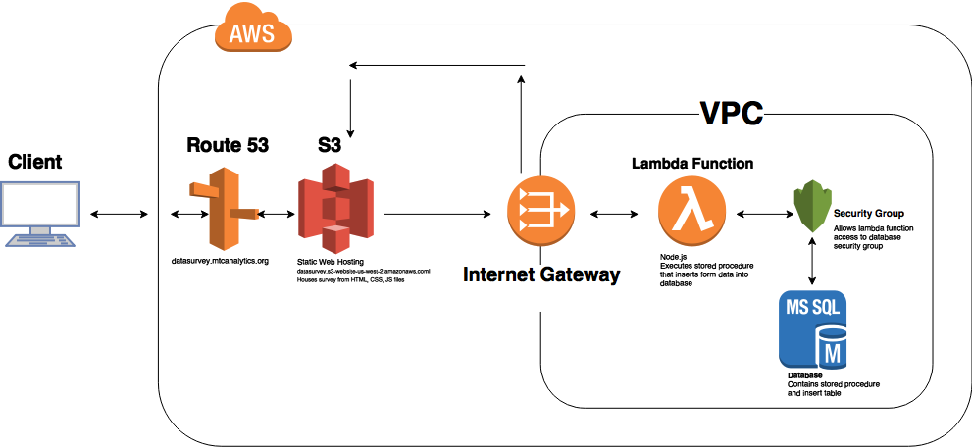
Investigation, or what is commonly know as “Gathering Business Requirements”

Slide 4
initial participation 28%
Web form/Excel Template
Data hunt
Email
In-Person Interview
“Drive-by”
Congratulations to Stephanie Mak for winning the Prize!

Slide 5
High volume of existing data
Heavy volume of existing tasks
Low Priority
Skepticism
Lack of clarity in purpose
save half of a million dollars by doing thorough inventory of existing data

Slide 6
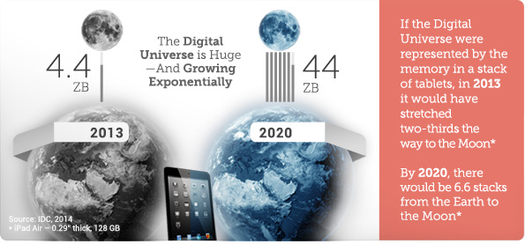
DATA GROWTH is
HIGHER then Bay Area
POPULATION GROWTH
phrase Garbage In Garbage Out has been in existence for 54 years

Slide 7
And over 100 MS Access databases…

Slide 8
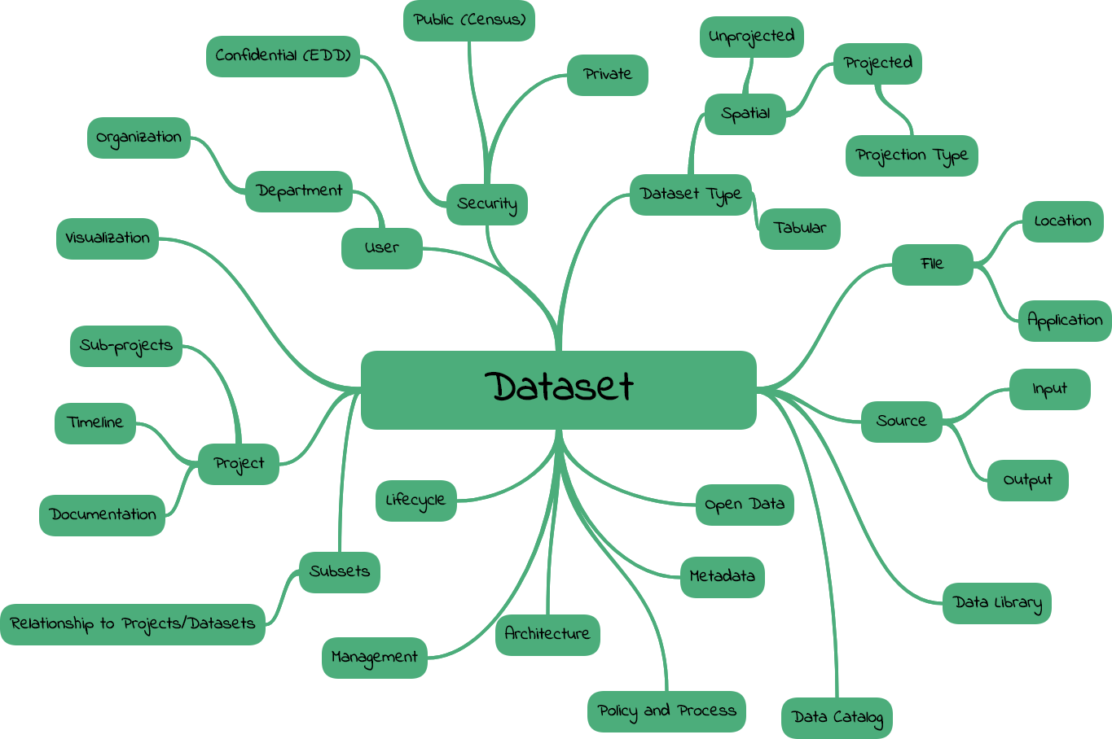

Slide 9
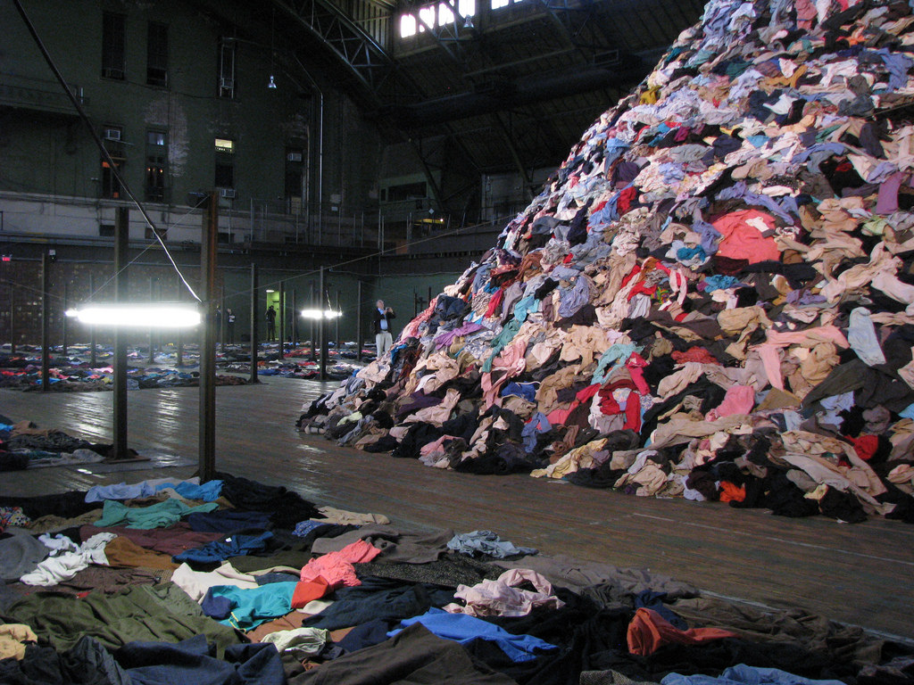
Closet Full of “Data”
Process

Slide 10
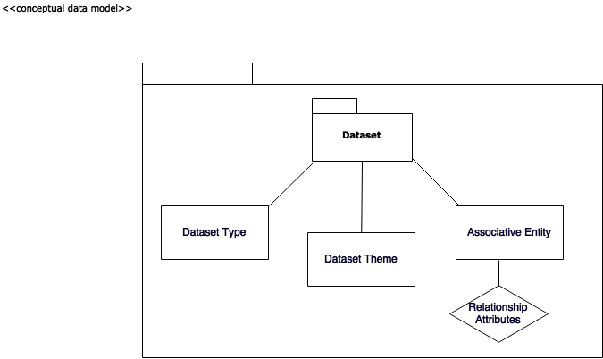
Started work on High Level Conceptual Design
time, availability and complexity

Slide 11
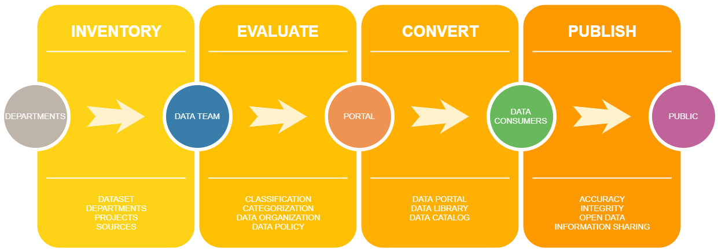
DONE
Gather initial business requirements
Sample of High Level Conceptual Data Model
TO DO
Develop a logical data model
Develop physical data model
Test Data model
Dataset Submission Form…..

Slide 12
Bay Area Metro Smart Data
What is Next….
Collaboration and cooperation
Comprehensive Data Inventory
Data Organization Process
Smart Data Tracking
and Publishing

